Slide 1
A Pilot Study of Computer Auto-Personalization at American Job Centers
J. Bern Jordan, Gregg Vanderheiden (Univ. of Maryland)
Maureen Kaine-Krolak (Raising the Floor-US)
Vera Roberts (OCAD University)
March 22, 2018

Slide 2
We are rapidly ’technifying’ all aspects of living –
education,
employment,
health,
transportation,
socialization,
our homes…

Slide 3

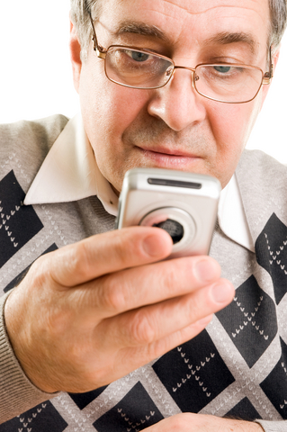
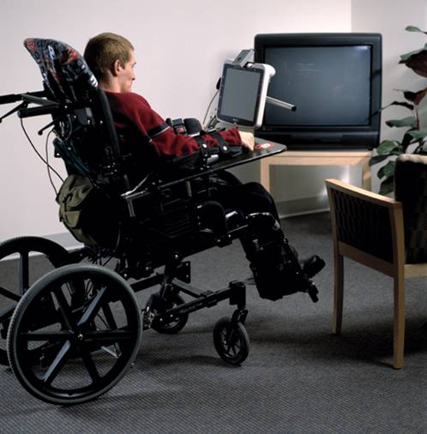

But the interfaces we put on these digital devices – are simply not usable by many - due to
Digital Literacy
Disability
Aging (memory & ability to learn new)

Slide 4
We have something of a Perfect Storm coming;
where just as access to ICT is becoming mandatory for meaningful participation, independence, and self sustenance,
we find that we not only are nowhere near providing access to everyone who needs it
but we are actually losing ground
technical proliferation -- across platforms,
product updates (breaking existing solutions)
decreasing social resources
and we still don't address cognitive, language, and learning disabilities well.

Slide 5
But if access to technology is mandatory –
Then anyone who cannot access it will be unable to participate in the world we are building
If only 5 percent can't understand and access
that is one in every 20 people or 375 million worldwide.
But the numbers are much higher
est 2 billion just for disability and literacy worldwide

Slide 6
OPTIONS ?

Slide 7
Leave some behind
(what we do today)
Design interfaces that can be used by all
(Not possible)
Create Flexible interfaces that can be adjusted to fit each person
(Promising, but who will adjust them)
Have them bring their own (AT)
Tried and true but Increasingly ineffective due to
Proliferation of platforms
Closed nature of many technologies

Slide 8
What if ?

Slide 9
Whenever a person approached a piece of technology
Its interface would suddenly change into some thing they could understand and use
No matter what their ability, digital literacy or ability to learn/remember

Slide 10
Here is what that might look like….

Slide 11
Notes:
Standard Windows Desktop showing three overlapping windows with Gmail, Picassa and and chat, each in its own window.

Slide 12
What if….
A teacher…
A grandparent in a family…
Students in school…
A cable box…
An elder approaching a ticket machine…

Slide 13
We call this auto-personalization
And it can make Cloud Computing not only be accessible to people with a wide range of disabilities
But auto-personalization can make Web and Cloud applications more understandable and useable by the population at large.

Slide 14
Not just for disability
Salesperson in a phone Kiosk…
Any user sitting down to a shared computer… at home… at a workstation, …
A company wanting to simplify and tailor workstations…
Anyone wanting to have their computer set up like another’s…

Slide 15
























































Notes:
Screen showing about 75 different logos representing the different partners. Full info on http://raisingthefloor.org website.

Slide 16
RtF organizations on 3 continents
RtF-Int’l (Geneva) Headquarters
RtF US (Washington DC)
RtF Canada (Toronto)
RtF Korea (Seoul)
And major projects covering all of the GPII core components
Fluid/FLOE
Cloud4all
Prosperity4All
Preferences for Global Access
UIITA-RERC
GPII-APCP

Slide 17
APCP and RERC Moving Research to Reality
Build a commercial quality implementation – and release it for public use.
Carry out Pilots in 4 high schools, a community college and 10 American Job Centers across the country
Will also be testing it in University and Public Libraries as part of a parallel project
Establish a Blue Ribbon Data Privacy Council

Slide 18
First Pilot Study

Slide 19
Overview of pilot study
Purpose of the study was to get computer user’s feedback while using the initial phase of GPII auto-personalization
A prototype of auto-personalization was tested
At an American Job Center in southern California
11 participants (4 female, 7 male)
Participants used NFC cards to adjust their computer settings while accomplishing job search related tasks
Answered quick surveys about experience

Slide 20
Methods
Interview and direct observation method to gather
How people felt about the system
Suggestions about additional features and uses
Task included “any computer task of participant’s choice” related to job search, while using GPII tool & instruction sheet
Verbal instruction were minimal
Initial prompt to view the instruction sign
Additional prompt to try another card if they didn’t naturally
Instructions given on how to use some of the Google Chrome extensions
Feedback was collected during and at the end of the session

Slide 21
Equipment
All-in-one computer with built in NFC reader (Windows 10)
Prototype version of GPII Auto-personalization
Chrome browser extensions
Google Dictionary by Google
High Contrast by Google Accessibility
click2Speech by Zsolt Nagy
Mercury Reader Chrome
11 NFC cards sorted in 4 logical groups:
Enlarging only
High contrast + enlarging
Text-to-speech
Magnifier
NFC cards were color coded with labels and short descriptions

Slide 22
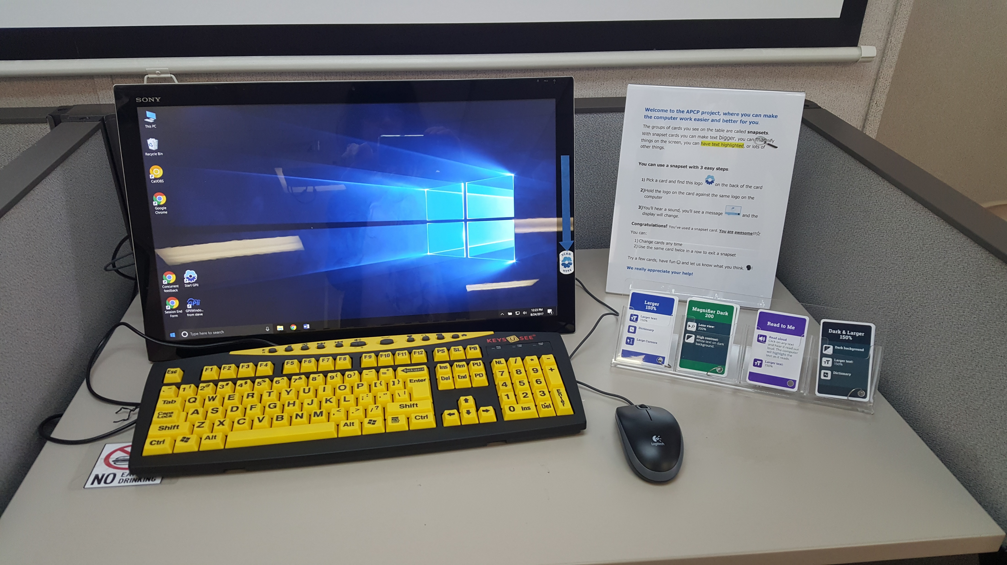
Workstation

Slide 23
Results
Among 11 participants
4 self-identified as having disability
2 – difficulties in seeing
2 – difficulties that would not ordinarily affect use of a computer
3 did not identify as having disability but mentioned the use of glasses or magnifier
Participants had mixed experience with computers; ranging from tech savvy to uncomfortable or fearful of technology
Ten participants tried at least one card from each group of NFC cards
On average, people tried 5.8 cards (SD 1.33)

Slide 24
Pre-survey Results

Slide 25
Short Survey after trying features
Short survey had 2 questions:
How much do you like using the last display settings?
Participants answered this for each feature and group of NFC cards tried
Scale 1 = “I don’t like it” to 5 = “I would use it often”
Favorable ratings: mean 4.2 (SD = 2.17)
Does your last setting make it easier or harder to use this computer?
Three responses, “It makes it harder to use”, “It doesn’t make a difference” & “It makes it easier to use”
Two questions were strongly correlated at 0.758 (Pearson correlation)

Slide 26
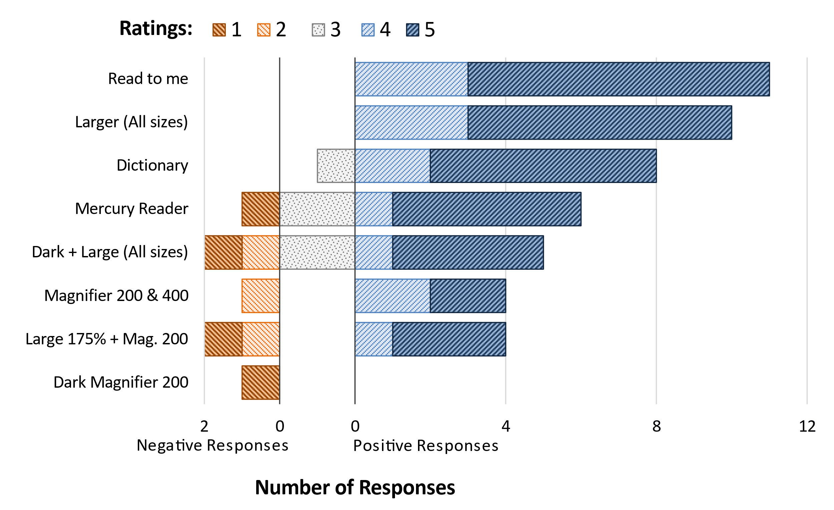
Short Survey Responses
Responses: How much do you like using the last display setting?

Slide 27
Additional Feedback
All participants said they would want to use auto-personalization again
Other places mentioned
Home (64%)
Work (45%)
Libraries (27%)
School
Airports
Public kiosk
Everywhere
Most helpful features
Text to speech with highlighting
Magnifying text
Three participants who mentioned very limited computer skills were successful

Slide 28
Discussion
Positive feedback
Would use a system with GPII again
Easy to apply settings
Made participants aware of built-in OS access features
Useful in multiple settings
Limitations
Participants had mild or no disability
No typical assistive technology users
Test only included limited assistive technology features
Exposure time to GPII system was limited
Only participants’ first encounters with GPII were recorded

Slide 29
Discussion
GPII has potential to address
Sensory disabilities
Low literacy
Low digital literacy
Second language learners
Cognitive, learning, or intellectual disabilities, mental health disorders
At AJCs there is potential to
Reduce staff time needed to assist customers making computers work better for them.
Help in accommodating customers without the need for staff to learn about, install, and support all the different assistive technologies.
Promote independence, confidence and a sense of agency for individuals who may otherwise have difficulty-using computers.

Slide 30
Conclusion
Positive reviews by AJC customers and staff in this early pilot
With additional pilots at AJCs and other locations, we hope to learn more & develop a better system

Slide 31
Acknowledgements
Rehabilitation Services Administration, U.S. Dept. of Education under grant H421A150006 (APCP), by the National Institute on Disability, Independent Living, and Rehabilitation Research (NIDILRR), U.S. Administration for Independent Living & U.S. Dept. of Education
European Union's Seventh Framework Programme
Flora Hewlett Foundation
Ontario Ministry of Research and Innovation
Canadian Foundation for Innovation, by Adobe Foundation
Consumer Electronics Association Foundation.

